Slide 1
EU Internal Market 2024-2025
Lecture 7: Free movement of goods after Brexit
Andreas Georgiou
andreas.georgiou@durham.ac.uk

Slide 2
The structure of lecture 7
The Withdrawal Agreement
The Trade and Co-operation Agreement
The UK Internal Market Act 2020

Slide 3
Brexit and free movement of goods
The options for the UK after Brexit
  The “Norway” model: the UK would become a member of the EEA and remain in the internal market
  The “Turkey” model: the UK would leave the internal market, but would remain in the Customs Union
  The “Canada+” model: the UK would conclude a free trade agreement with the EU
What were the main free movement issues in the Article 50 TEU process?
  The rights of EU citizens in the UK and UK citizens in the EU (see lecture 10)
  The Good Friday Agreement and the border between Northern-Ireland and Ireland

Slide 4
Brexit and free movement of goods
The proposal supported by Theresa May: a “backstop” with the UK in the Customs Union
The solution proposed by Boris Johnson: a border between Great Britain and Northern-Ireland
Protocol on Ireland/Northern-Ireland in the Withdrawal Agreement

Slide 5
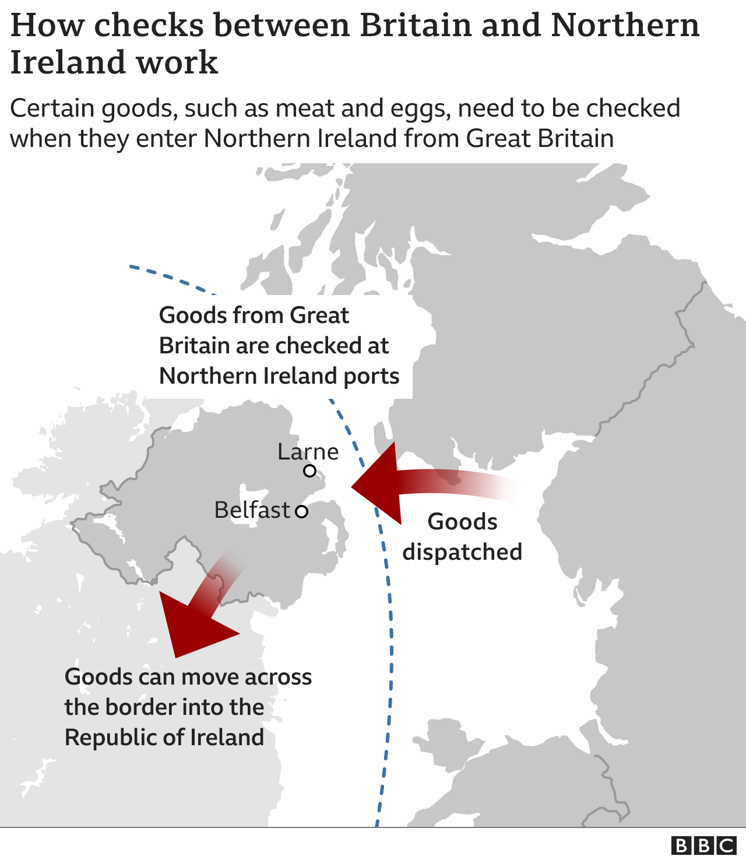
The Withdrawal Agreement
Article 5(5) of the Protocol: the UK has to comply with Articles 30 and 110 TFEU with respect to Northern-Ireland, which remains part of the EU’s Customs Union
Similarly, no quantitative restrictions on imports and exports between the EU and Northern Ireland are allowed

Slide 6
The Trade and Co-operation Agreement
An association agreement concluded under Article 217 TFEU
No more free movement of goods, but: zero tariffs and no quotas
Customs formalities and checks on UK goods entering the EU (including health inspections of products)
The “Windsor Framework” (February 2023)

Slide 7
The UK Internal Market
The “legacy” of EU free movement law: the UK Internal Market Act 2020
An internal market for goods, services and professional qualifications between the devolved administrations of the UK: England, Scotland, Wales and Northern-Ireland
A “codification exercise” of the CJEU’s case law on Article 34 TFEU
Market access principles: mutual recognition (Cassis de Dijon) and non-discrimination (Keck)

Slide 8
The UK Internal Market
Section 3: the principle of mutual recognition is applicable to “relevant requirements” such as product requirements: statutory requirements relating to the characteristics, presentation or production of the goods
Section 4: the principle of non-discrimination is applicable to “relevant requirements” such as manner of sale requirements: direct and indirect discrimination against goods from another part of the UK is prohibited
Section 10 (and Schedule 1): exclusion of market access principles where there is a “serious threat to human, animal or plant health” presented by a “pest or disease” or “unsafe food”
Section 8(6): indirectly discriminatory rules can be justified on the basis of “the protection of the life or health of humans, animals and plants” or “the protection of public safety or security”

Slide 9
The UK Internal Market
The aim of the creation of the UK Internal Market: centralisation of regulatory power in Westminster?
The scope of the UK Internal Market: material and formal scope (statutory requirements only)
The enforcement of the UK Internal Market: no “direct legal effect” of the market access principles
Interesting articles by Steve Weatherill (Yearbook of European Law) and Kenneth Armstrong (Modern Law Review)

